Slide 1

Machine learning in biology, genomics, and health care
Machine Learning Summer School 2019
Barbara Engelhardt
Princeton University
Genomics Plc

Slide 2
Biomedical data pose big challenges for ML
p >> n problem: the number of features is greater than the number of samples
Data missingness: missingness often not at random
Noise: often non-normal, often with heavy tails
Confounding: batch effects, population structure, and feature correlation
Zero assumption fails: real (but small) effects are hard to distinguish from null
n=1 problem: some samples don’t look like any other
Causality: often observational data is available; often instruments are absent

Slide 3
But, many ideas in ML have proven useful...
Hierarchical models to share strength across limited samples
Priors to encode complex structure among features
Sparsity for removing features not relevant to a pattern
Explicit quantification of uncertainty
Many different data distributions; incorporating multiple data types
Autoencoders for feature extraction from complex phenotypes
Fast inference for large or streaming data and real-time problems

Slide 4
In this tutorial, I will focus on three challenges
Polygenic risk scores: prediction or supervised learning
Analytic question: can we use your genotype data to predict your risk of heritable diseases?
Module discovery: exploratory data analysis or unsupervised learning
Analytic question: given observations, can we estimate covariance, find co-varying features
Hospital patient advice: sequential decision-making or reinforcement learning
Analytic question: given patient data, can we determine interventions with the most promise?

Slide 5
Biology: a very concise primer
The big questions in biology usually involve biological mechanism
How does population variation arise?
What are the essential components of this mechanistic pathway?
What are the non-essential components of this mechanistic pathway?
Where does this mechanistic pathway act?
How is this process disrupted? How effective are these disruptions?
Do disruptions or interventions have secondary effects on the system?
These aren’t necessarily the analytic problems ML naturally addresses
While not all biological applications of ML address mechanism directly, most of them are in the service of the elucidation of mechanism and disruption

Slide 6
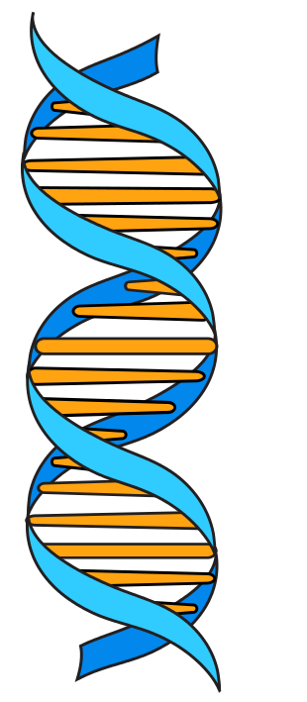
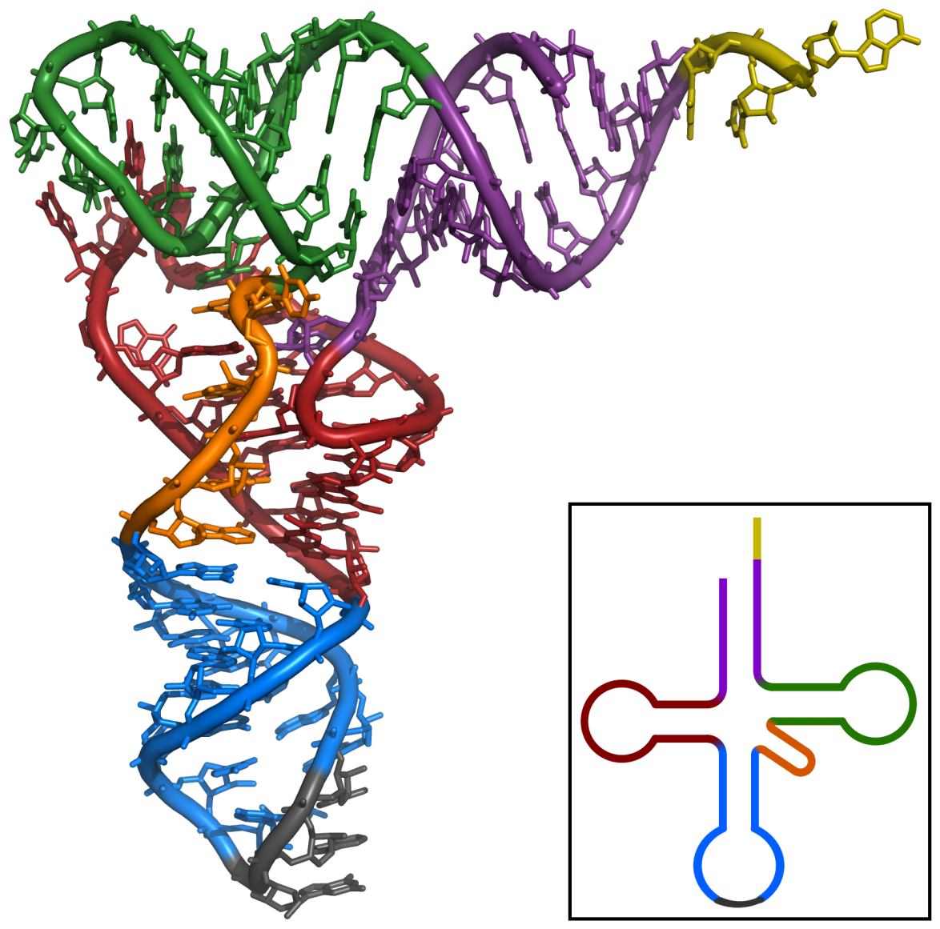
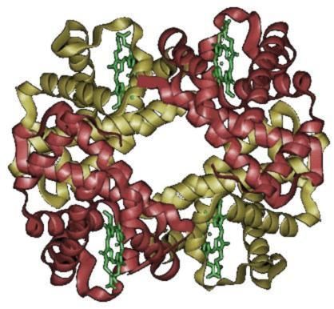
DNA to RNA to protein
transcription
translation
DNA
RNA
Protein
[Wikimedia, Wikipedia]

Slide 7
Deoxyribonucleic Acid (DNA)
DNA
Four characters (bases, nucleotides): A, C, G, and T
In humans:
22 autosomal chromosomes, two pairs (one from mother, one from father)
X X (female), X Y (male)
Mitochondrial DNA (mother)
3 billion bases; ~20,000 protein-coding genes

Slide 8
DNA to RNA
DNA
Transcription
RNA
Four characters: A, C, G, and U
Exons transcribed to RNA; introns spliced out
Transcription occurs in the cell nucleus
Messenger RNA (mRNA) transported from nucleus

Slide 9
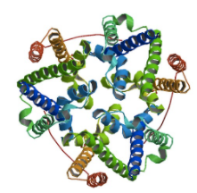
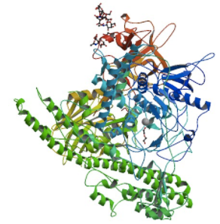
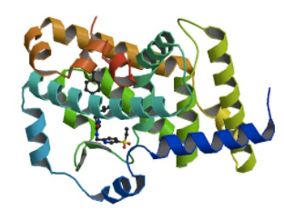
DNA to RNA to protein
DNA
Transcription
RNA
Translation
Protein

Slide 10
RNA to protein
RNA
Translation
Protein
20 characters: amino acids
Translation happens in the cell cytoplasm
Main functional units in cells
Very difficult to quantify directly

Slide 11
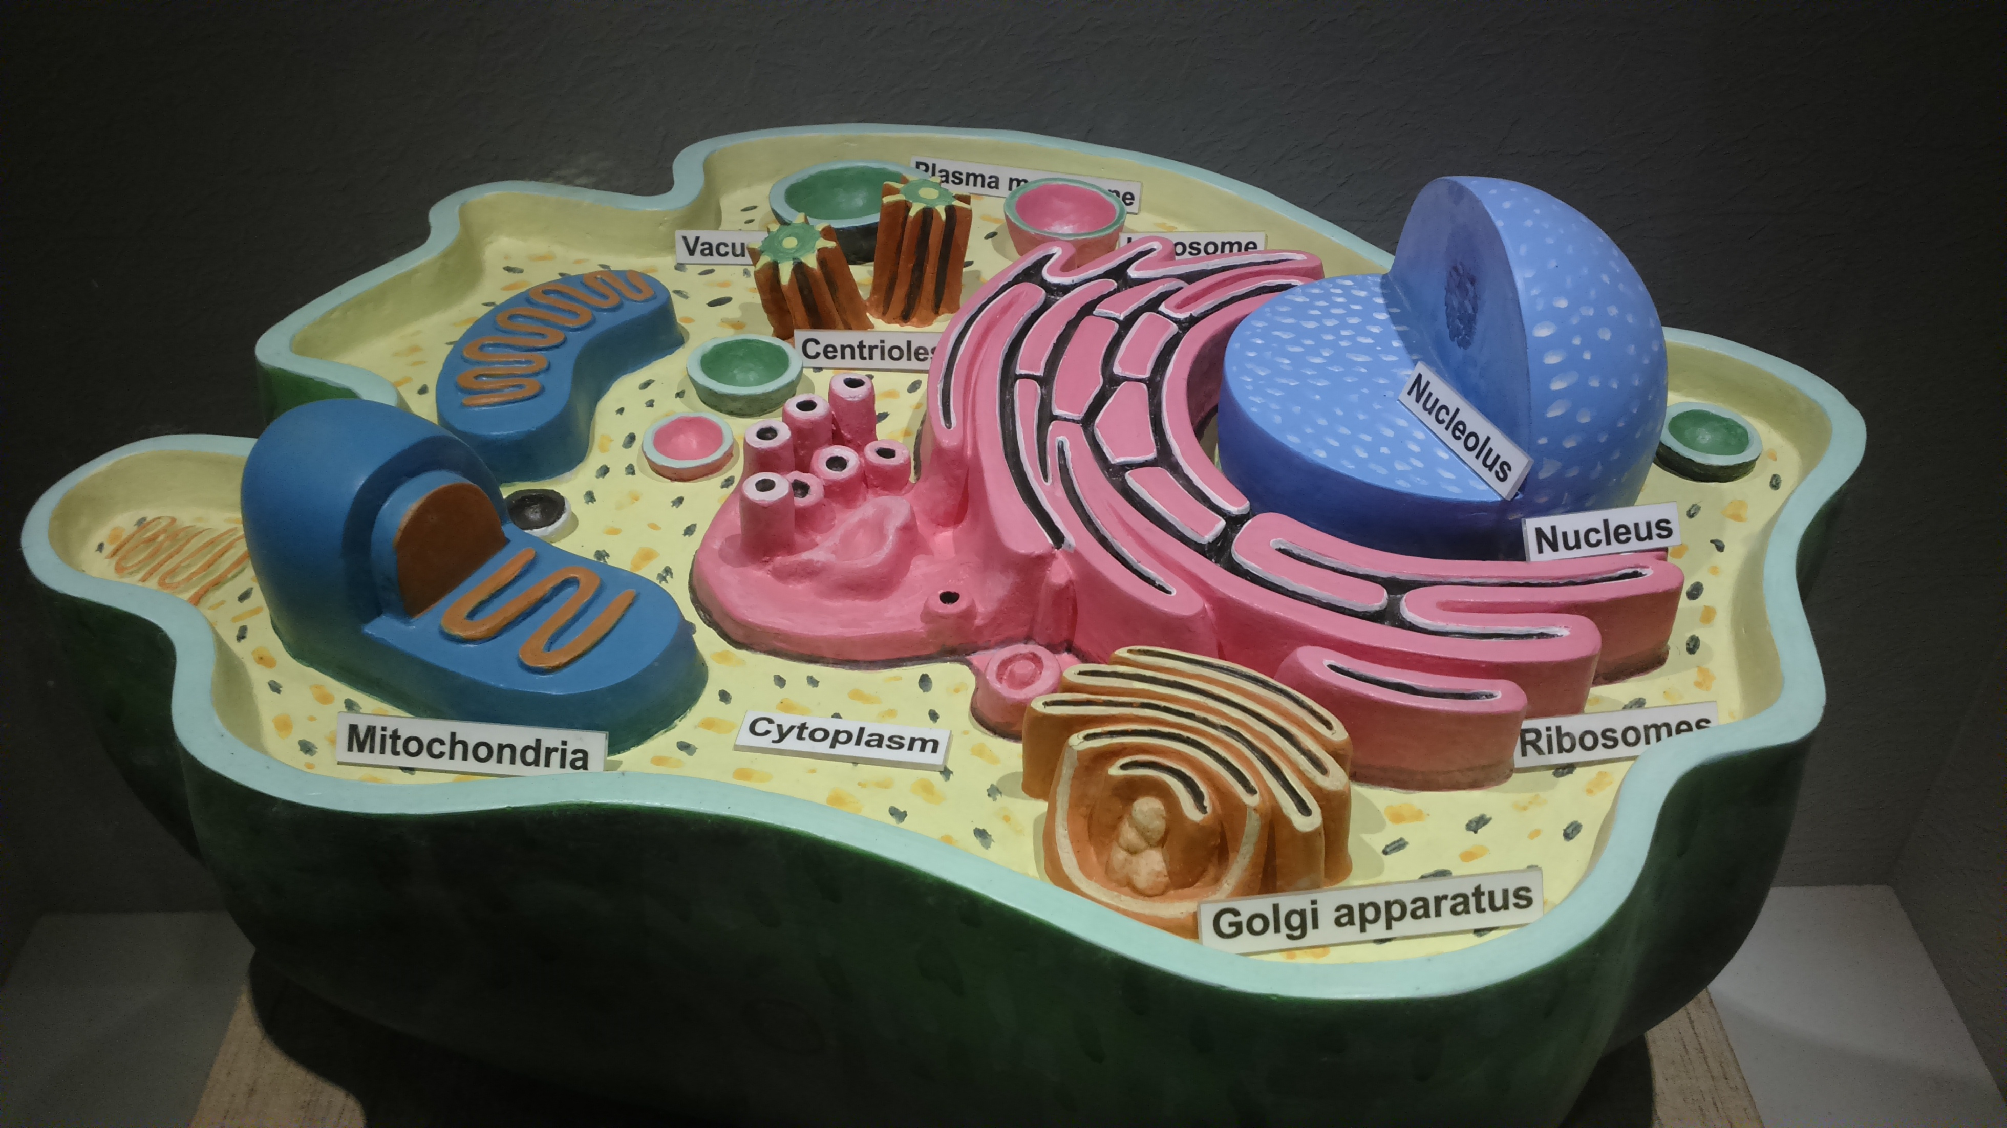
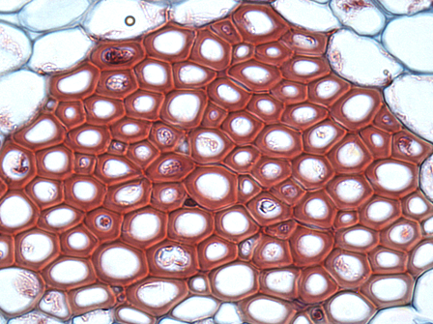
Proteins, cells, and tissues
Protein
Cell
Tissue
[Wikipedia]

Slide 12
Tissues, organs, and individuals
Tissue
Organ
Individual
[Wikipedia; GTEx 2017]

Slide 13
Population diversity from genomic diversity
Variation in Environment
Variation in DNA
Variation in individuals
[Wikipedia; GTEx 2017]

Slide 14
Genotype to phenotype? How does this work?
Mendelian traits: one mutation leads to disease with very high probability (e.g., sickle cell anemia)
Complex traits or polygenic model: many mutations affect trait or disease risk (e.g., type II diabetes, height)
Omnigenic model: causal mutations of complex traits are uniformly spread across the genome
Pleiotropy: mutations may be causal of more than one complex trait
[Wikipedia; GTEx 2017]

Slide 15
Quantitative genetics: genotype to phenotype
Identifying genotypes associated with traits
Predicting traits/disease risk from genotype
Genetic architecture of phenotypic traits
Genes & tissues where dysregulation leads to disease
Using genotypes as instrumental variables for causal inference
Drug and intervention design and development
[Wikipedia; GTEx 2017]

Slide 16
ML for biomedicine: Always ask these questions
How were these samples selected?
How were these samples collected?
Were there multiple batches of the collection? Differences in instrumentation? Different technicians? Variation in the samples?
How were the raw data normalized?
What is the question were are asking of these data? Is it possible to find the answer in these data?

Slide 17
Quantify RNA in a sample: RNA-sequencing
Fragment RNA

Slide 18
RNA-sequencing: sequence and align
RNA fragments
Sequence fragments
Align reads to a reference genome

Slide 19
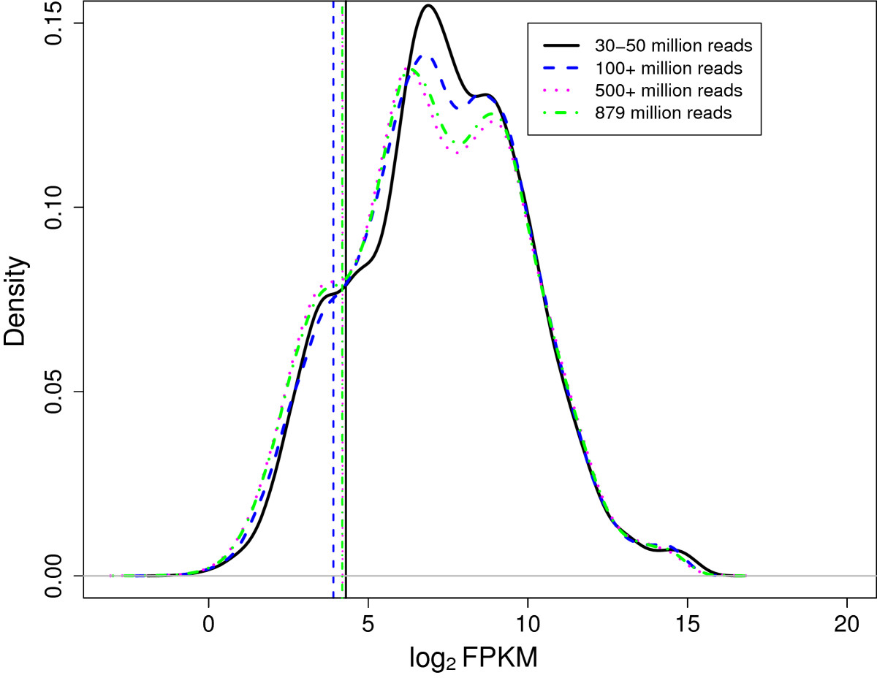
RNA-sequencing: gene quantification
Fragments per kilobase per million reads (FPKM) per gene
Across n samples
samples
genes
Density from [George & Chang, 2014]

Slide 20
Why do we study RNA levels in tissue samples?
Genetic variation
Many complex traits are inherited:
Height, BMI, longevity, fertility
Schizophrenia, T2D, cardiovascular disease, cancer
Gene expression mediates relationship between genetic variation and complex traits
eQTL analysis
Genome-wide association studies
Gene expression
Gene expression
profiling
Complex traits
[Nicolae 2010]
Notes:
This mediation often happens in a specific tissue, instead of across all tissues
Dysregulation of gene expression levels also can be sign of disease or indicate a drug target

Slide 21
Part 1: Polygenic scores (PSs)
PSs: given genetic markers, predict
risk of a disease (breast cancer, Alzheimer’s)
value of quantitative trait (BMI, height)
age at which event occurs (heart attack, menopause)
Supervised learning problem; many variants:
What if we know current age?
What if we want survival curves across time?
Can we compete survival curves against each other?
[Wikipedia; GTEx 2017]

Slide 22
Association of genotype with quantitative trait

Slide 23
Genotype to trait: simple linear regression
T
=
+
Y
=
β^{Τ}
X
+
ε
[Wang & Blei, 2018]

Slide 24
Genotype to trait: Confounding
Batch effects
T
=
+
Linkage disequilibrium
Y
=
β^{Τ}
X
+
ε
Population structure
[Wang & Blei, 2018]

Slide 25
PS plus Kaplan-Meier curves
Can look at quantiles (ranking) in score, and stratify survival using Kaplan-Meier curves
Different quantiles have very different progression rates
For some diseases this is useful; for general health, combine diseases [Ranganath, 2016]
Alzheimer’s disease progression
[Kauppi et al. 2018]

Slide 26
What does this mean for PS?
Population structure confounds all around, even among small distances
Sometimes genotype data not available, but only summary statistics
Sometimes confounders not collected (e.g., age) but important
If minor allele frequency and linkage disequilibrium are different by population, is it possible to consider transfer learning on given PS?
Random forests/Neural networks not obvious choices here

Slide 27
Genotype to trait: confounding & reproducibility
[Berg et al. 2019]

Slide 28
What else can we use supervised learning for?
Normalization and batch correction “regressing out”
Identifying events in data (e.g., EKG signals)
Classifying functional regions (e.g., coding or non-coding region)
Statistical hypothesis testing
Experimental design (e.g., contextual bandits)
Estimating heritability and effect sizes

Slide 29
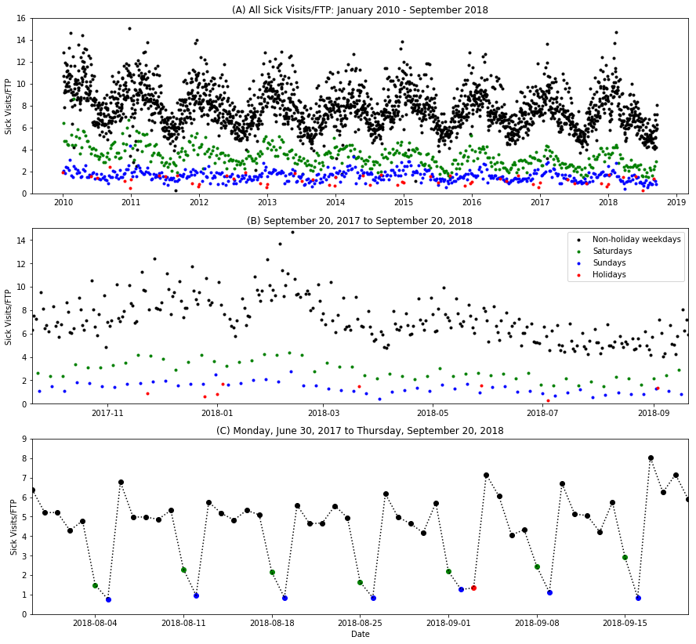
Pediatric outpatient clinic: number of sick-child visits/day
Schedule clinicians, well-child visits months in advance, but want to reduce wait time
Model seasonality of sick-child visits (day, week, month, holiday)
Model outbreaks of viral diseases
Model disease categories separately (flu, norovirus, etc.)
MSE reduced from 2.45 (constant) to 0.56 (RNN) by modeling patients
[Guan & Engelhardt 2019]

Slide 30
Part 1 summary
Start with most simple model first (we are underpowered)
Consider, correct for confounders
Even then, it is complicated…
What are appropriate benchmarks?
How do we validate (prospective vs retrospective; different populations)?

Slide 31
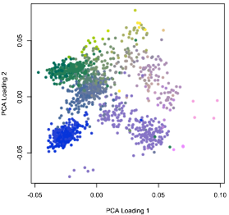
Part 2: Unsupervised Learning for module discovery
Explore your data (“exploratory data analysis” or EDA)
Find patterns and trends among samples, features
Develop data-driven hypotheses to test out-of-sample
Focus on interpreting fitted model rather than prediction
Often a visual analysis: focus on graphics, plots
[Tukey, 1977]

Slide 32
EDA is undervalued in biology because it is hard to do well
Many assumptions are not well characterized
No null hypothesis, or tests of statistical significance
Often conclusion is based on qualitative evidence
Oversimplified models might miss biologically important patterns
Results hard to evaluate, validate, and reproduce

Slide 33
Why hierarchical latent variable models?
Tradeoff between expressiveness and computational tractability
Models that are more expressive:
Genomics, neuroscience data are often not Big Data
Sample-limited, feature rich (p >> n) [West 2003]
Machine learning & statistics developed in Big Data context
Highly structured models are often essential to recover signal
Estimated parameters have mechanistic interpretations
How can we achieve computational tractability? Many ways.
Explore the field of approximate inference

Slide 34
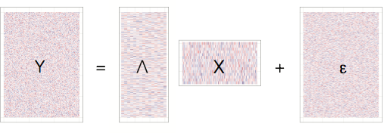
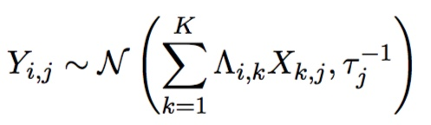
Bayesian latent factor models for EDA
samples
K
samples
samples
K
genes
genes
K
genes
Matrix Y is an observation of p features over n samples
Factor analysis: project matrix Y into linear subspace X (factors) using weights Λ (loadings), with independent Gaussian noise ε:

Slide 35
Examples of latent factor models
samples
K
samples
samples
genes
genes
K
genes
Many methods have interpretation as latent factor models:
Principal component analysis (PCA): orthogonal factors, loadings
Admixture models (LDA): loadings and factors on simplex
Non-negative matrix factorization (NMF): count data
Factor regression models: fixed effects, random effects

Slide 36
Principal components recapitulate geography of Europe
For each genotype: subtract mean, divide by standard deviation
Compute covariance matrix of genotypes
Compute principal components using singular value decomposition
Plot PC1 vs PC2; color each point by ancestry
[Novembre & Stephens 2008; Engelhardt & Stephens 2010]

Slide 37
Sparse factor analysis recapitulates geography of Europe
Fit sparse factor analysis to genotype matrix with K>2
Plot Factor 1 vs Factor 2; color each point by ancestry
[Engelhardt & Stephens 2010]

Slide 38
Latent Dirichlet allocation recapitulates geography
Fit latent Dirichlet allocation to genotype matrix with K=4
Four “topics” represent four corners of the space
[Engelhardt & Stephens 2010]

Slide 39
Challenges with latent factor models
Data likelihood in factor model is invariant to orthogonal rotation, scale, and label switching
samples
K
samples
samples
genes
genes
K
genes
What do these invariances mean?
factors may be correlated
factors will not be comparable within or across applications
hard to “label” the factors in a meaningful way

Slide 40
Ideas to address EDA difficulties
samples
K
samples
samples
genes
genes
K
genes
How can we overcome these challenges to enable biological discovery?
add sparsity for interpretability and rotational invariance
study structure that is invariant to matrix rotations
validate interesting patterns and test hypotheses using held out data

Slide 41
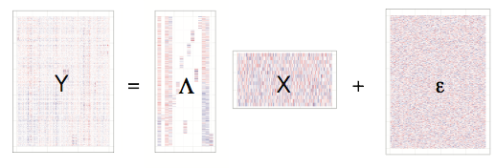
Interpretability via sparsity
Add sparsity (zeros) to columns of Λ
samples
K
samples
samples
genes
genes
K
genes
Regularize Λ globally, factor-wise, and locally:
Global: shrink every value to zero
Factor-wise: rescue some components, remove unused components
Local: add factor-specific proportion of zeros
[Gao et al. 2013]

Slide 42
Mixtures of sparse and dense factors
But, not all contributors to variation are sparse
samples
K
samples
samples
genes
genes
K
genes
Model both sparse and dense factors using a two component mixture model
[Leek & Storey 2007, Chandrasekaran et al. 2009, Gao et al. 2013]

Slide 43
Biclustering: sparsity in factors and loadings
samples
K
samples
samples
X
K
Y
=
Λ
+
ε
genes
genes
genes
Biclusters recovered for each component: non-zero elements in bicluster
[Gao et al. 2016]

Slide 44
Finding patterns in variation in a data matrix
samples
Y
=
+…+
ε
genes
Λ₁X₁
+
Λ₂X₂
Λ_{Κ}X_{K}
+
Rewrite the matrix product as the sum of outer products of K components
Each matrix captures some source of variation in data
variation may affect subset of features, or all;
variation may be found in a subset of samples, or all (biclustering)

Slide 45
Partitioning sources of (co)variation
samples
Y
=
Λ₁X₁
Λ₂X₂
+…+
ε
genes
+
Λ_{Κ}X_{K}
+
Latent factors: many components of gene expression variation
Technical covariates: batch, library prep
Biological covariates: tissue heterogeneity, age, sex, BMI
Population structure: sample ancestry
Genomic covariates: co-regulated gene networks, expression QTLs
[Gao et al. 2016]

Slide 46
Integrate over factors to get covariance estimate

Slide 47
Partial correlation (precision matrix) is available
Invert the regularized covariance matrix to recover precision matrix
Suitably normalized, partial correlation can be computed from this precision matrix
Partial correlation: correlation between gene A, B controlling for all other genes

Slide 48
Partial correlation yields Gaussian graphical model
…also known as a Gaussian Markov random field

Slide 49
Validate edges using expression QTLs
Validation allows us to find 27 additional expression QTLs beyond known (hundreds)

Slide 50
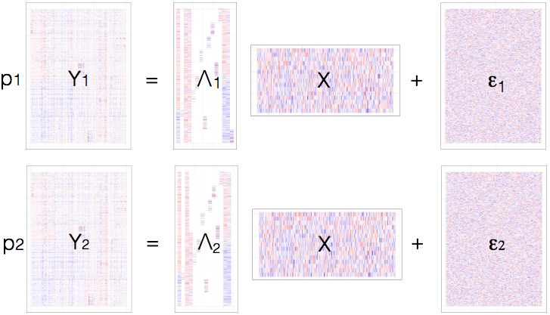
Sparse canonical correlation analysis
Modify latent factor model to consider two observations
[Zhao et al. 2016]

Slide 51
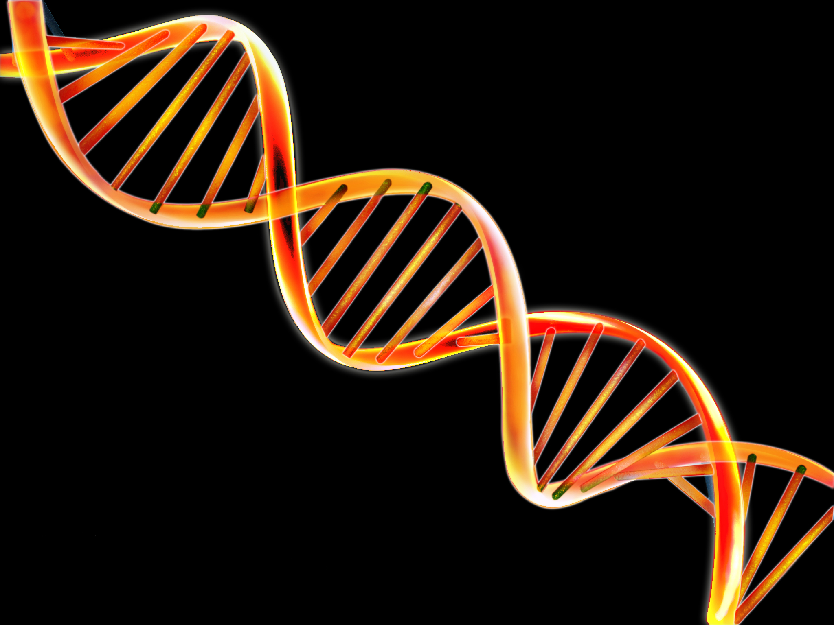
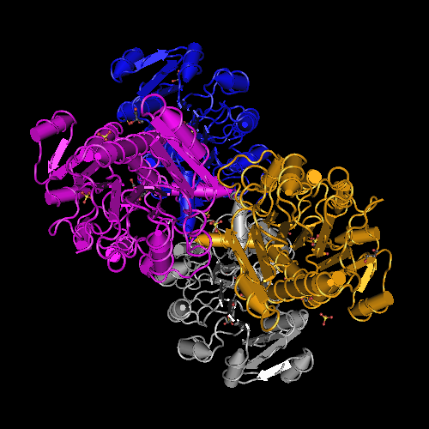
Genotypes can affect tissue morphology
mutation on chr 9
Lactate Dehydrogenase D
Epithelial cells specific to colon
[Dym et al. 2000]
[Ash, Darnell, Munroe et al. 2019]

Slide 52
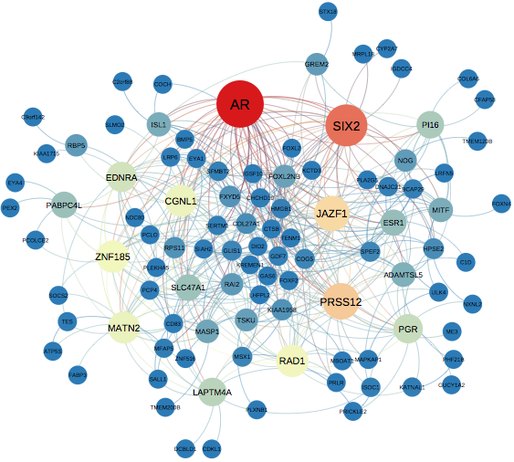
Part 2 summary
Unsupervised learning can be used for discovery
Partition variation in data – heterogeneous sources of variation
Interpret that variation – give it a name
Develop a hypothesis and test that hypothesis
Partition might need to be high dimensional

Slide 53
Part 3: Decision-making and patient data
Precision medicine: clinical decision-making driven by characteristics of patient and disease

Slide 54
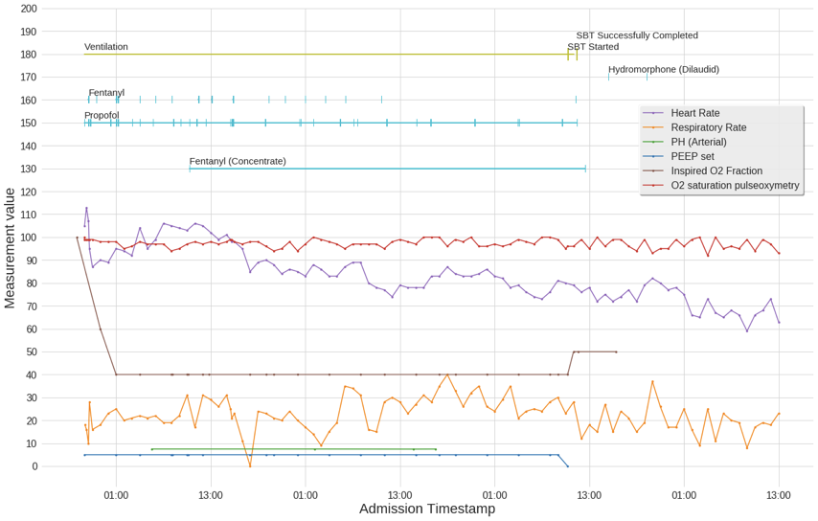
Hospital patient data: UPenn Hospitals

Slide 55
Opportunities for AI in precision medicine
Diagnosis, screening, time-to-event (supervised learning)
Co-morbidities, Med2vec, search, PatientsLikeMe (unsupervised learning)
Hospital policies, chronic disease treatments (off-policy RL)
Adaptive clinical trials and drug design (sequential decision making)
ML4Health in rural clinics, at home, other countries (domain adaptation)
Real-time patient interventions (optimization, bounded rationality)
Helping hospitals and clinics run efficiently (operations research)
Help to avoid human errors (ethics, law, bias)
Understanding images or language (vision, NLP)

Slide 56
Challenges of precision medicine for AI
Missing, sparse, unlabeled, unstructured, heterogeneous, longitudinal, niche data
Communication between clinicians, patients, and machine learnists/ML tools is poor
We do not have the tools or metrics to determine that AI is improving medicine
Ethics, biases, and legal responsibilities of healthcare mistakes are unknown
Hype around AI for precision medicine has lead to sloppy, overvalued ML tools, mistrust
Not clear yet what our role in the space of aiding precision medicine is…?

Slide 57
Many lessons to be learned in this area…
We cannot model every patient covariate
Statistics in medical data often have heavy tails – outliers are important
Model patients well, not only clinicians and clinical decisions
Evaluating learned policies is nearly impossible
Build methods to focus clinicians and screen patients, not replace MDs
Doctors aren’t stupid and AI isn’t magic

Slide 58
First, build a model of patient state…
We model 4 vital signs and 20 lab results that are most common;
Many covariates we did not model;
Summarizing overall patient state, urgency of care is important when considering outcome;
Reinforcement learning approaches can use estimates of patient state from this model to inform clinical decision-making.
[Cheng et al. 2019]

Slide 59
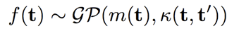
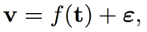
Modeling patient state
Patient measurements are sparse, irregularly sampled, and noisy
Typical approach: impute using “sample-and-hold”
Multi-output Gaussian processes: jointly model vitals, labs by estimating covariance within & between covariates [Futoma et al. 2017; Soleimani et al. 2018]
We set m(t) = 0 and k(t,t’) as a kernel in the linear coregionalization model with a spectral kernel as the basis function
[Cheng et al. 2019; Feinberg et al. 2017]

Slide 60
Mixture of spectral kernels
[Cheng et al. 2017]

Slide 61
Neoplasm patients, estimated MedGP kernel
[Cheng et al. 2017]

Slide 62
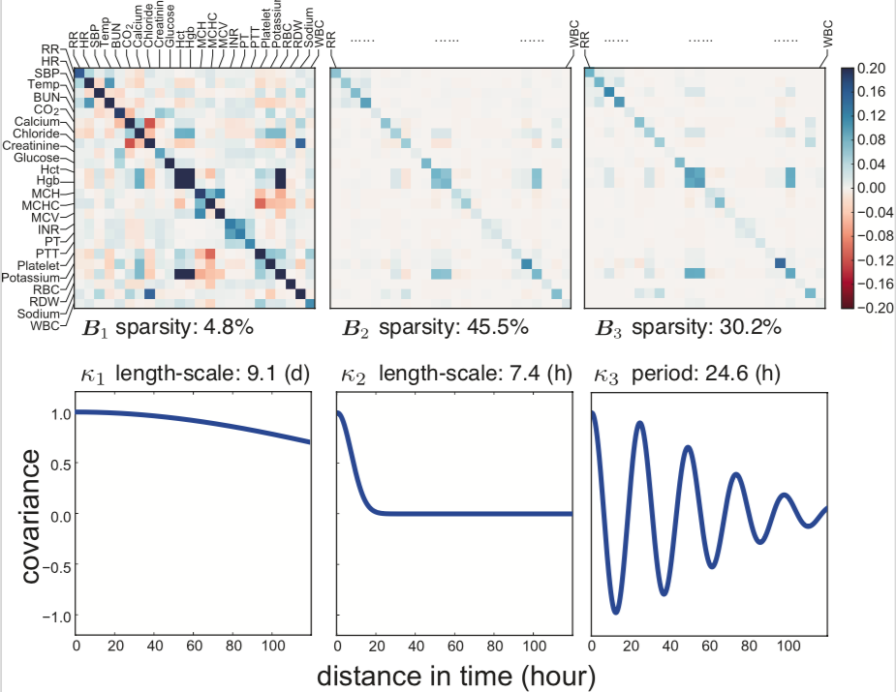
Septic patients, estimated MedGP kernel
[Cheng et al. 2017]

Slide 63
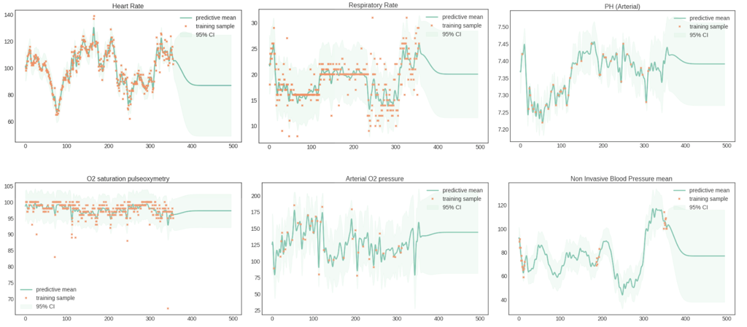
Estimates of patient state with MedGP
[Cheng et al. 2017]

Slide 64
But patient data are more complicated than GPs

Slide 65
Improve patient model: response to interventions
Clinical interventions are meant to positively impact patient state:
Sedatives will reduce respiratory rate, heart rate
Antibiotics will reduce white blood cell count
These intervention responses are not modeled well by a Gaussian process, which assumes smoothness of physiological state of patient
Model of how each patient will respond to each intervention at each dosage will allow better clinical decision making; can be incorporated into RL methods
Extend “baseline” stationary model with latent force model, which estimates a push of specific covariates away from baseline model, and a return to baseline
“causality” and “counterfactuals” [Schulam & Saria 2017]
[Cheng et al. 2019]

Slide 66
Latent force models for response to three drugs
Heparin and warfarin are blood thinners, affect ability to form blood clots
PTT: partial thromboplastin time
INR: International normalized ratio
Metoprolol is a is a beta-blocker used to reduce blood pressure
SBP is systolic blood pressure
HR is heart rate
[Cheng et al. 2019]

Slide 67
Latent force models: heparin for PTT and INR
[Cheng et al. 2019]

Slide 68
Latent force models: metoprolol for systolic BP and HR
[Cheng et al. 2019]

Slide 69
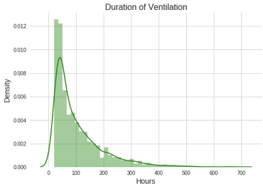
Reinforcement learning: Mechanical ventilation in the ICU
Invasive mechanical ventilation uses mechanical means to assist spontaneous breathing through penetration of mouth or skin.
At any given hour, 40% of ICU patients are ventilated
Typically coupled with sedation to maintain comfort and stability
Need for mechanical ventilation arises from diverse conditions

Slide 70
Weaning patients from ventilators
Premature weaning can lead to higher rates of reintubation
Delayed weaning can lead to over-sedation, delirium, infection
Our goal: clinician-in-the-loop decision support tool
Alert caregivers when patient is ready for weaning;
Recommend ventilation settings and sedation for ventilated patient

Slide 71
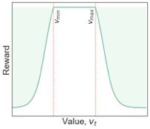
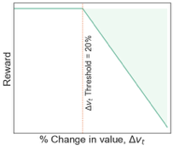
Reinforcement learning: Ventilator removal
A Markov decision process (MDP) is defined by
State variables s_{t} ∈ S: 34 features including demographic data, time-varying vitals, sedatives, vent duration, reintubation number.
An action space, from which an action is chosen at each time step of vent settings, sedative dosage levels, administer spontaneous breathing trial, remove vent
Reward function R(s_{t}, a_{t}), the observed feedback for taking action a at time t
We want to penalize:
prolonged ventilation
vitals exceeding desired ranges
sharp changes in vitals
failed spontaneous breathing trials
reintubation within ICU admission
[Prasad et al. 2018]

Slide 72
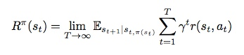
Markov Decision Process (MDP)
Given patient histories as states, actions, and rewards ⟨s₀, a₀, r₁, s₁, a₁, r₂, s₂, a₂, r₃, s₃ …⟩^{n} we solve the following optimization problem to find an optimal policy π(s):
Idea is to optimize the expected accumulated reward
But, in our system,
system dynamics are challenging to estimate (transition function);
we cannot evaluate the estimated policy directly.
[Prasad et al. 2017]

Slide 73
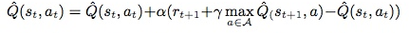
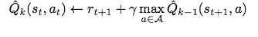
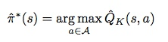
Fitted Q-iteration for off-policy RL
A Q function maps state-action pairs to expected rewards, estimated using Bellman recursion:
Fitted Q-iteration is a model-free, off-policy, batch mode RL algorithm that uses one-step transitions to learn Q functions with iterative optimization of supervised learning problems (iterations K):
Q functions: extremely randomized trees (extra-trees) [Ernst et al. 2005]
Q functions: Neural-fitted Q [Riedmiller et al. 2005]
[Prasad et al. 2017]

Slide 74
Example results: doctors and RL differ
[Prasad et al. 2017]

Slide 75
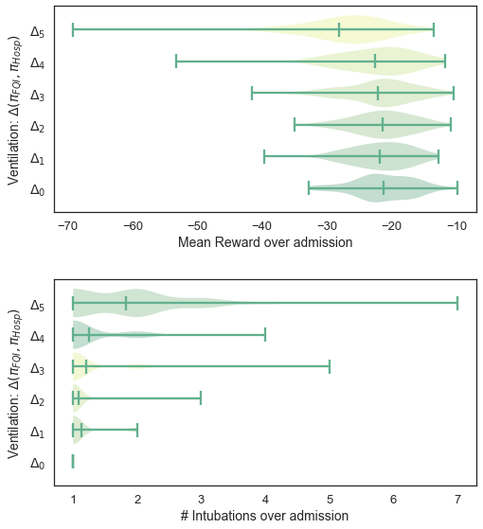
Evaluating learned policies on held-out data
[Prasad et al. 2017]

Slide 76
Evaluating learned policies is a critical challenge
Observational data for off-policy evaluation is more challenging that we were expecting [Gottesman et al. 2018]
Not all covariates are modeled. Could patients corresponding to Δ5 be diabetic?
Hospital policies are often different, making comparisons across cohorts hard
Rewards and patient priorities change over time: no reward says “prevent bed sores”
[Prasad et al. 2017]

Slide 77
The distribution tails cannot be ignored
Google search has approximately 5.6B searches per day; 15% are unique.
Google can get away with poor results on these 15% of searches; we cannot.
Generalization error is misleading as a metric. How big is our biggest mistake?
Validation needs to account for patient types that have never been seen before (e.g., importance sampling).
[Prasad et al. 2017]

Slide 78
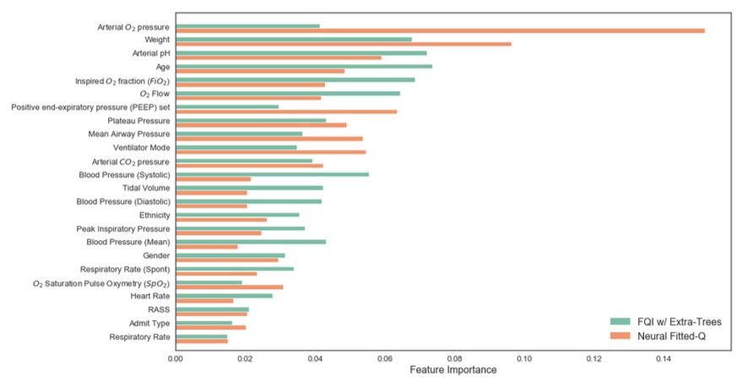
FQI vs NFQ: Ventilator removal feature importance
[Prasad et al. 2017]

Slide 79
RL for low risk decisions: Lab test administration
Laboratory tests are essential to understand patient state, make clinical decisions, start interventions
Lab tests are often performed as panels (blood-based); can be expensive
>90% of patients in inpatient setting have blood-draw induced anemia
We chose this problem because success means three things:
Clinicians should order tests only when test provides diagnostic information for patient
We save the hospital money by reducing the tests ordered
We can test our our RL method in the inpatient setting
[Cheng et al. 2019]

Slide 80
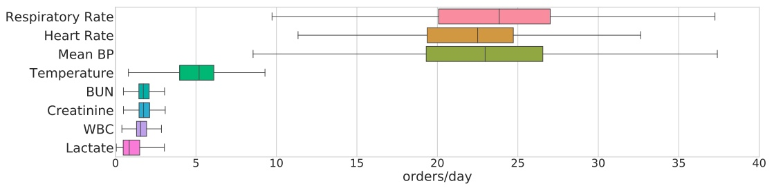
Lab test administration: orders per day per patient
We designed RL to advise on timing of four blood tests: lactate, creatinine, blood urea nitrogen, and white blood cell counts
These tests are used to diagnose a number of conditions including kidney failure and blood-based infection (sepsis)
[Cheng et al. 2019]

Slide 81
Lab test administration: orders per day per patient
Reward function includes: information gain of test, recency of last test, probability of patient being in a state that requires clinical intervention, cost of test
We used Pareto optimization to estimate weights of each of the reward components;
We chose the point on the Pareto frontier closest to doctors’ observed lab test policies (but see brilliant work from [Zanette & Brunskill, 2018])
[Cheng et al. 2019]

Slide 82
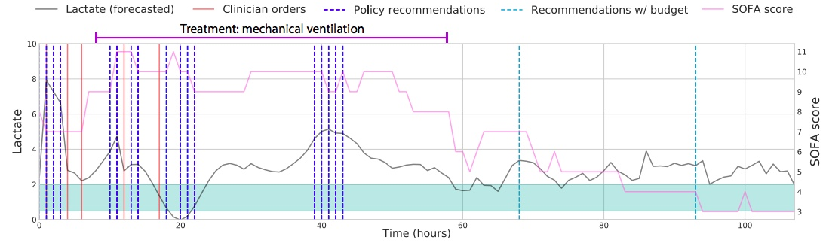
Lab test administration: Example results
Reduced number of lab tests taken as much as 44% (WBC); Lactate saw smallest improvement because it is not ordered as often
Improved initiation of care for critical patients by as much as four hours
[Cheng et al. 2019]

Slide 83
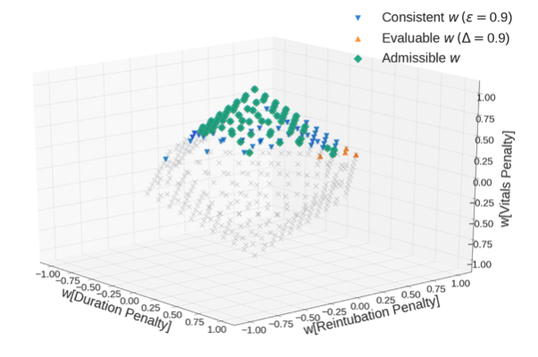
Inverse RL: estimate reward function from trajectories
Since evaluation is hard, let’s try another direction: learn ‘evaluable’ reward functions
Let’s also learn evaluable functions that are consistent with a set of data ‘trajectories’
Unlike robotics, we assume new data cannot be collected and no simulator is available
This allows us to put safety nets on reward functions, ensure we can evaluate and compare them
with Finale Doshi-Velez (Harvard)
[Prasad et al. 2019]

Slide 84
Evaluable and consistent reward learning
Assume the agents are epsilon-optimal in their behavior (i.e., observed policies)
Assume functional form of reward function (weighted linear with three components)
Used Pareto optimization to identify values of weights for reward function that are
Evaluable: able to be evaluated based on trajectories
Consistent: produce policies consistent with trajectories
Admissible: produce weights within constraints
Evaluation of policies with test data is possible
with Finale Doshi-Velez (Harvard)
[Prasad et al. 2019]

Slide 85
Ventilator weaning: reward function weights
with Finale Doshi-Velez (Harvard)
[Prasad et al. 2019]

Slide 86
Rethinking how we model data in precision medicine
Big Data for precision medicine means generalizing across patients
Generalizing across patients often means covariates are not being modeled
Low dimensional projections of patients might hide key to precision medicine
I think precision medicine needs to go the opposite direction: building approaches for the n=1 problem, where each sample is complex
Important ideas to model n=1 data carefully: microclustering, shuffling methods, dictionary learning

Slide 87
Part 3 summary
Effort needs to be put into modeling patient state because the tails are important and also the most challenging
Thought needs to be put into how these policies are evaluated given constraints of medical domain and patient safety

Slide 88
Summary and Practical Advice
You have the ability to have a real impact on human health and basic biology
Supervised learning can be used to identify patients to screen for prevention
Unsupervised learning can be used to discover new biological hypotheses
Reinforcement learning takes easy clinical decisions out of clinicians’ hands
Biology and medicine work on a different timescale than ML
Validation and “hold out data” mean something different than in ML
Learning to communicate with biologists/clinicians is hard but important
“Applied ML is an NP-hard problem” – never clear when you have to start over
Always do the easiest thing first, even if it won’t get you a NeurIPS paper
Pull every thread [Rahimi & Recht, “test of time award” NeurIPS 2017]

Slide 89
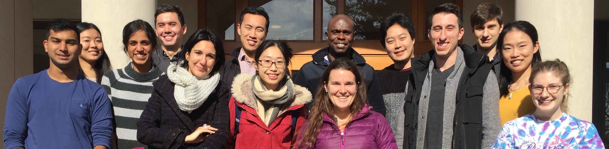




Acknowledgements
Group Members
Collaborators
Diana Cai
Mark Carty
Allison Chaney (Duke)
Li-Fang Cheng (Verily)
Greg Darnell (Brown)
Bianca Dumitrascu (Duke/ENS/MIT)
Roberta de Vito (Brown)
Ariel Gewirtz
Greg Gundersen
Brian Jo
Guillaume Martinet
Niranjani Prasad
Will Townes
Archit Verma
Michael Zheng
Ryan Adams (Princeton)
Corey Chivers (UPenn)
Michael Draugalis (UPenn)
Finale Doshi-Velez (Harvard)
Kai Li (Princeton)
Sayan Mukherjee (Duke)
Jonathan Pillow (PNI)
Aviv Regev (Broad/MIT)
Jared Toettcher (MOL)

